Slide 1

DEPARTMENT OF INFORMATION TECHNOLOGY
DATABASE MANAGEMENT SYSTEM

Slide 2
UNIT -I
INTRODUCTION TO DBMS
File Systems Organization - Sequential, Pointer, Indexed, Direct - Purpose of Database System- Database System Terminologies-Database characteristics- Data models – Types of data models – Components of DBMS- Relational Algebra. LOGICAL DATABASE DESIGN: Relational DBMS - Codd's Rule - Entity-Relationship model - Extended ER Normalization – Functional Dependencies, Anomaly- 1NF to 5NF- Domain Key Normal Form – Denormalization.

Slide 3
INTRODUCTION TO DBMS
Field
ROLL_NO | NAME | PERCENTAGE | GRADE
1 | Priya | 56 | 2
2 | Vijay | 76 | 1
3 | Ramya | 60 | 1
4 | Kavitha | 42 | 3
5 | Ram | 44 | 3
File
Record
Field Content

Slide 4
Operations on file
Create
Write
Read
Rewind
Delete
Close
Open
Modify

Slide 5
File System
Method of organizing and retrieving files from a storage medium .
It is an index or database containing the physical location of every piece of data on the hard drive or other storage device.

Slide 6
File System Organization
How files are mapped onto disk
Sequential Access Organization
Pointer Organization
Indexed sequential organization
Direct Access organization

Slide 7
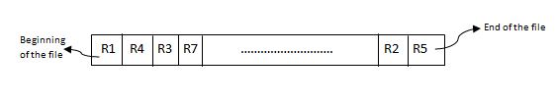
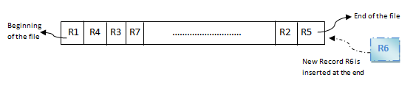
FILE ORGANIZATION
SEQUENTIAL ACCESS ORGANOZATION
Records are arranged in sequential order.
INSERT RECORD

Slide 8
FILE ORGANIZATION(CONTD)
POINTER ORGANIZATION
Records are chained together by pointers to permit fast retrieval in search key order
Book_no:01
Book_name : let Us C
Author_Name : B.Balaji
Next:04
Book_no:22
Book_name : let Us C Solution
Author_Name : B.Balaji
Book_no:04
Book_name : let Us C++
Author_Name : B.Balaji
Next:04
Next:22

Slide 9
FILE ORGANIZATION(CONTD)
Two-way chain
Book_no:01
Book_name : let Us C
Author_Name : B.Balaji
Next:04
Book_no:22
Book_name : let Us C Solution
Author_Name : B.Balaji
Book_no:04
Book_name : let Us C++
Author_Name : B.Balaji
Previous:01
Previous:04
Previous:*
Next:04
Next:22
Next:*

Slide 10
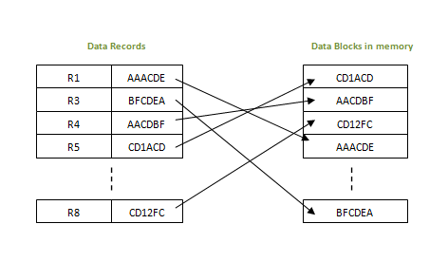
FILE ORGANIZATION(CONTD)
INDEXED-SEQUENTIAL ACCESS ORGANIZATION
Address index is appended to the record, index is nothing but the address of record in the file.
If any record has to be retrieved, based on its index value, the data block address is fetched and the record is retrieved from memory.

Slide 11
FILE ORGANIZATION(CONTD)
DIRECT-ACCESS FILE ORGANIZATION
Records are placed randomly throughout the file.
Records need not be in sequence because they are updated directly and rewritten back in the same location.
New records are added at the end of the file or inserted in specific locations based on software commands.
Records are accessed by addresses that specify their disk locations. An address is required for locating a record, for linking records, or for establishing relationships.

Slide 12
Purpose of Database Systems
Database management systems were developed to handle the following difficulties of typical file-processing systems supported by conventional operating systems:
Data redundancy and inconsistency
Difficulty in accessing data
Data isolation – multiple files and formats
Integrity problems
Atomicity of updates
Concurrent access by multiple users
Security problems

Slide 13
Purpose of Database Systems
Data redundancy and inconsistency
Same information may be duplicated in several places.
All copies may not be updated properly.
Difficulty in accessing data
May have to write a new application program to satisfy an unusual request.
E.g. find all customers with the same postal code.
Could generate this data manually, but a long job...
Data isolation
Data in different files.
Data in different formats.
Difficult to write new application programs.

Slide 14
Purpose of Database Systems
Multiple users
Want concurrency for faster response time.
Need protection for concurrent updates.
E.g. two customers withdrawing funds from the same account at the same time - account has $500 in it, and they withdraw $100 and $50. The result could be $350, $400 or $450 if no protection.
Security problems
Every user of the system should be able to access only the data they are permitted to see.
E.g. payroll people only handle employee records, and cannot see customer accounts; tellers only access account data and cannot see payroll data.
Difficult to enforce this with application programs.

Slide 15
Purpose of Database Systems
Integrity problems
Data may be required to satisfy constraints.
E.g. no account balance below $25.00.
Again, difficult to enforce or to change constraints with the file-processing approach.

Slide 16
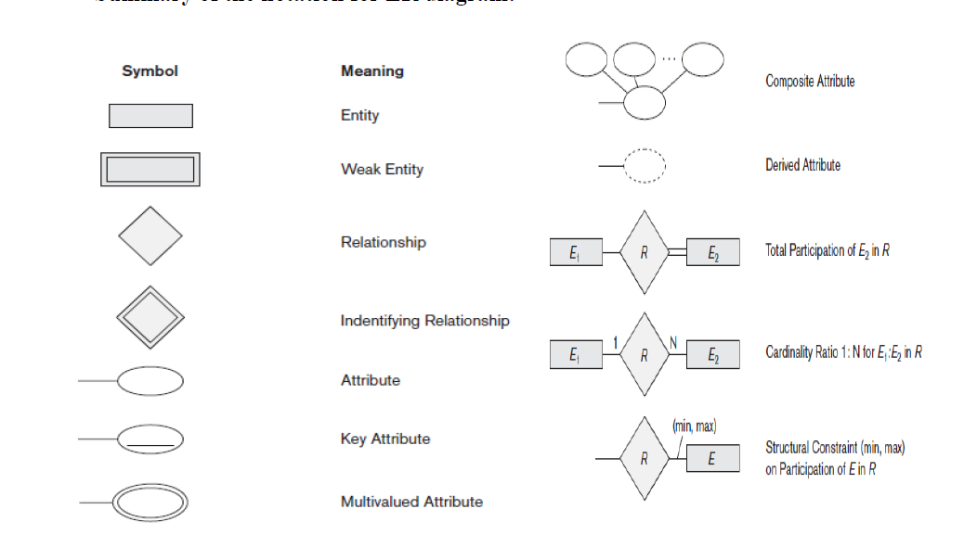
Entity Relationship Diagram

Slide 17
DATABASE SYSTEM TERMINOLOGIES
Database – a collection of information related to a particular topic or purpose. There are two types of databases: Non relational and relational.
Database management system – a program such as Access, that stores, retrieves, arranges, and formats information contained in a database.
Database model – the structure of the information stored in the database. This model should included how each individual piece of information relates to all the other information in the database.
Field – a specific item of information containing a homogenous set of values throughout the table. Fields appear as columns in a table and as cells in a form.

Slide 18
DATABASE SYSTEM TERMINOLOGIES
Table
This is the structure defined to store data under it. It is also called as an ENTITY.
Fields
It is also known as attributes in database terminology. It defines the property of an entity. In other words it is called as column in a table.
For example if we have a company where employee details and department details are gathered.
Employee details like empname, age, address and so on each of which form attribute is stored under structure called as EMP table
Similarly department details like department name, manager and so on each of which denote field are stored in a structure called d DEPT table. Relational Database is nothing but organizing data in tabular form by creating structures as above.

Slide 19
DATABASE SYSTEM TERMINOLOGIES
Column (field, attribute)
A column is the smallest unit of storage in a relational database. A column represents one piece of information about an object. Every column has a name and a data type. Columns are grouped into rows, and rows are grouped into tables. In Figure 1.1, the shaded area depicts a single column.
Row (record, tuple)
A row is a collection of column values. Every row in a table has the same shape (in other words, every row is composed of the same set of columns).
View
A view is an alternative way to present a table (or tables). You might think of a view as a "virtual" table. A view is (usually) defined in terms of one or more tables.

Slide 20
DATABASE SYSTEM TERMINOLOGIES
Commit
A commit marks the successful end of a transaction.
When you perform a commit, you are telling PostgreSQL that you have completed a unit of operation and that all the changes that you made to the database should become permanent.
Rollback
A rollback marks the unsuccessful end of a transaction.
When you roll back a transaction, you are telling PostgreSQL to discard any changes that you have made to the database (since the beginning of the transaction).
Index
An index is a data structure that a database uses to reduce the amount of time it takes to perform certain operations.
Result set
When you issue a query to a database, you get back a result set. The result set contains all the rows that satisfy your query. A result set may be empty.

Slide 21
DATABASE SYSTEM TERMINOLOGIES
Normalization
Normalization is required because
To structure the data so that pertinent relationship between entities or tables can be maintained
To permit simple retrieval of data in response to queries.
For simple maintenance of data when updates, insertions and deletions take place.
To reduce the need to restructure or reorganize data when new application requirement arise.
There are four levels of normalization. They are namely:
First Normal Form
Second Normal Form
Third Normal Form and
Boyce Codd Normal Form
In each level redundancy of data is reduced.

Slide 22
DATABASE SYSTEM TERMINOLOGIES
JOIN:
Rows of one table need to be joined with rows in another by common values in corresponding columns is done in database terminology by using JOIN concept.
Referential Integrity
It is created on a table with reference to another table or tables.
In this concept foreign key figures out.
The table on which the column or a combination of columns is defined by this constraint is called the foreign key is called child table.
When this constraint is defined a relation is defined between this table which has the foreign key and a table that has the primary key in relationship with this.

Slide 23
DATABASE SYSTEM TERMINOLOGIES
This is called as referenced key.
The table which has the primary key or in other words the referenced key is called as parent table.
Primary Key
A primary key is a special relational database table column (or combination of columns) designated to uniquely identify all table records.
A primary key's main features are: It must contain a unique value for each row of data.
It cannot contain null values.
Foreign Key
It is defined as a column or set of columns in a child table to declare referential integrity constraint.

Slide 24
DATABASE SYSTEM TERMINOLOGIES
Deadlock
Transaction is unit of work done.
Database management system will have number of transactions.
There may be situations when two or more transactions are put into wait state simultaneously .
In this position each would be waiting for the other transaction to get released.
Suppose we have two transactions one and two both executing simultaneously.
In transaction numbered one we update student table and then update course table. We have transaction two in which we update course table and then update student table.

Slide 25
CHARACTERISTIC OF DATABASE
Should be able to store all kinds of data that exists in this real world.
Should be able to relate the entities / tables in the database by means of a relation. i.e.; any two tables should be related.
Data and application should be isolated.
There should not be any duplication of data in the database.
DBMS has a strong query language. Once the database is designed, this helps the user to retrieve and manipulate the data
Multiple users should be able to access the same database, without affecting the other user.

Slide 26
CHARACTERISTIC OF DATABASE
It supports multiple views to the user, depending on his role.
Database should also provide security, i.e.; when there are multiple users are accessing the database, each user will have their own levels of rights to see the database.
Database should also support ACID property. i.e.; while performing any transactions like insert, update and delete, database makes sure that the real purpose of the data is not lost.
For example, if a student’s address is updated, then it should make sure that there is no duplicate data is created nor there is any data mismatch for that student.

Slide 27
RELATIONAL MODEL
CUSTOMER
Name | Street | City | Account_no
John | North | Queens | 900
Smith | Sidehill | Brooklyn | 101
Smith | Sidehill | Brooklyn | 209
Kim | Lake view | Perryidge | 303
ACCOUNT_INFO
Account_no | Balance
900 | 5000
101 | 3000
209 | 7000
303 | 8000

Slide 28
HIERARCHICAL MODEL
A B C
EE F G
H I J
90 10
99 101
25 49
13 21

Slide 29
Network Model

Slide 30
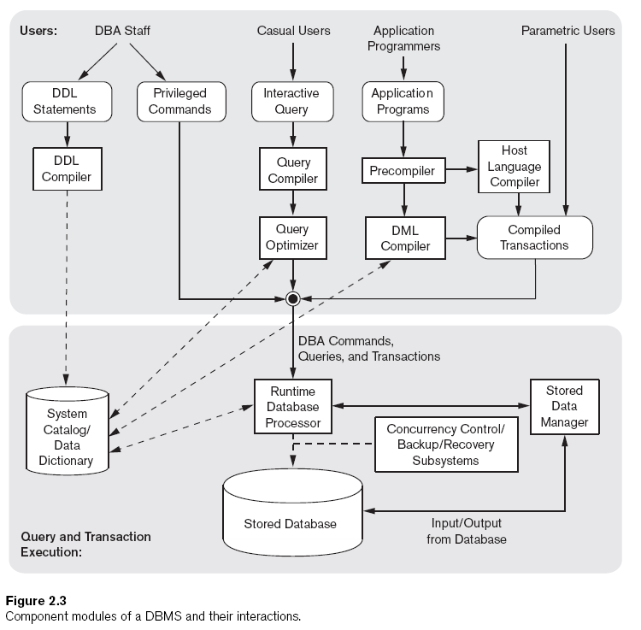
COMPONENTS OF DBMS

Slide 31
COMPONENTS OF DBMS(CONTD..)
The top part of the figure refers to the various users of the database environment and their interfaces.
The lower part shows the internals of the DBMS responsible for storage of data and processing of transactions.
Let us consider the top part of Figure:
1. It shows interfaces for
The DBA staff, casual users who work with interactive interfaces to formulate queries,
application programmers who program using some host languages,
parametric users who do data entry work by supplying parameters to predefined transactions.

Slide 32
COMPONENTS OF DBMS(CONTD..)
2. The DDL compiler: processes schema definitions, specified in the DDL, and stores descriptions of the schemas (meta-data) in the DBMS catalog.
3. Casual users and persons with occasional need for information from the database interact using some form of interface called as interactive query interface.
4. Query compiler: handles high-level queries that are entered interactively.
5. The query optimizer is concerned with the rearrangement and possible reordering of operations, elimination of redundancies, and use of correct algorithms and indexes during execution.

Slide 33
COMPONENTS OF DBMS(CONTD..)
6. Application programmers write programs in host languages such as Java, C, or C++that are submitted to a precompiler.
7. The precompiler extracts DML commands from an application program written in a host programming language.
8. DML compiler: compiles the DML commands into object code for database access.
9. The rest of the program is sent to the host language compiler.

Slide 34
COMPONENTS OF DBMS(CONTD..)
10. The object codes for the DML commands and the rest of the program are linked, forming a canned transaction whose executable code includes calls to the runtime database processor.
Now, Let us consider the lower part of figure
1. Run-time database processor: handles database access at run time. It receives retrieval and update operations and carries them out on the database.
2. It also works with the stored data manager, which controls access to DBMS information that is stored on disk through interaction with operating system.
3. Concurrency control and backup and recovery systems are integrated into the working of the runtime database processor for purposes of transaction management.

Slide 35
COMPONENTS OF DBMS(CONTD..)
Database System Utilities
There are some functions that are not provided through the normal DBMS components rather they are provided through additional programs called utilities. Some of these are:
1. Loading or import utility: used to load or import existing data files into the database.
2. Backup utility: used to create backup copies of the database, usually by dumping the entire database onto tape.
3. File reorganization utility: is used to reorganize a database file into a different file organization to improve performance.
4. Performance monitoring utility: is used to monitor database usage and provides statistics to the DBA.

Slide 36
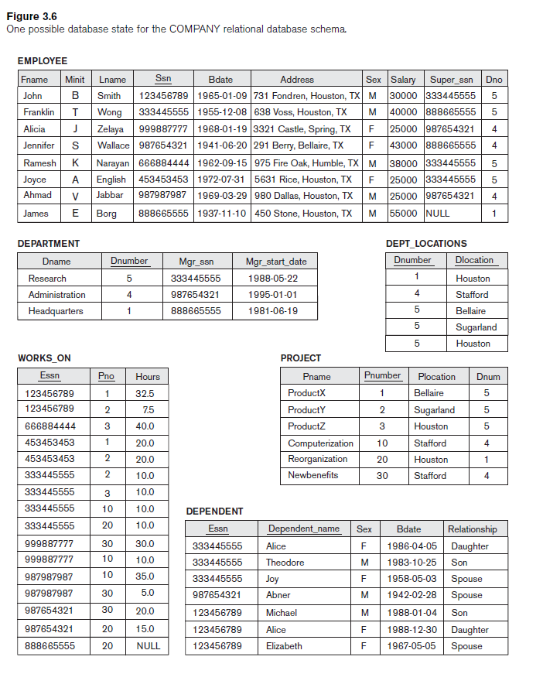

Slide 37
RELATIONAL ALGEBRA
The basic set of operations for the relational model is known as the relational algebra.
These operations enable a user to specify basic retrieval requests.
A sequence of relational algebra operations forms a relational algebra expression, whose result will also be a relation that represents the result of a database query.
Unary Relational Operations
Relational Algebra Operations from Set Theory
Binary Relational Operations
Additional Relational Operations

Slide 38
UNARY RELATIONAL OPERATIONS
SELECT OPERATION
The Select operation ( denoted by σ ( sigma))can be used to select those tuples of a relation that satisfy a given condition.
Notation: σ _{<selection condition>}(R)
σ : select operator ( read as sigma)
R: relation name
Examples of select expressions
Obtain information about a professor with name giridhar
σ name= “giridhar”(professor)

Slide 39

UNARY RELATIONAL OPERATIONS(CONTD..)
Obtain information about professors who joined the university between 1980 and 1985
σ startYear≥1980 ^ startYear < 1985(professor)
To select the tuples for all employees who either work in department 4 and make over $25,000 per year, or work in department 5 and make over $30,000, the following SELECT operation is given:
σ(Dno=4 AND Salary>25000) OR (Dno=5 AND Salary>30000)(EMPLOYEE)

Slide 40
UNARY RELATIONAL OPERATIONS(CONTD..)
The Boolean conditions AND, OR, and NOT
have their normal interpretation, as follows:
(cond1 AND cond2) is TRUE if both (cond1) and (cond2) are TRUE; otherwise, it is FALSE.
(cond1 OR cond2) is TRUE if either (cond1) or (cond2) or both are TRUE; otherwise, it is FALSE.
(NOT cond) is TRUE if cond is FALSE; otherwise, it is FALSE.

Slide 41
UNARY RELATIONAL OPERATIONS(CONTD..)
SELECT Operation Properties
The SELECT operation σ_{<selection condition>}(R) produces a
relation S that has the same schema as R
The SELECT operation is commutative; i.e.,
_{σ<condition1>}(σ_{< condition2>} ( R)) = σ _{<condition2>} (σ _{< condition1>} ( R))
A cascaded SELECT operation may be applied in any order; i.e.,
σ _{<condition1>}(σ _{< condition2>} (σ _{<condition3>} ( R)) = σ _{<condition2>} (σ _{< condition3>} (σ _{< condition1>} ( R)))
A cascaded SELECT operation may be replaced by a single selection with a conjunction of all the conditions; i.e.,
σ _{<condition1>}(σ _{< condition2>} (σ _{<condition3>} ( R)) = σ <condition1> AND < condition2> AND < condition3> ( R)

Slide 42
UNARY RELATIONAL OPERATIONS(CONTD..)
PROJECT OPERATION
The project operation(denoted by π(pie)) can be used to keep only the required attributes of a relation instance and throw away others.
Notation: π_{<attribute list>}(R)
π:project operator(read as pie)
R: relation name
Examples of project expressions
To list each employee’s first and last name and salary, the PROJECT operation is used as follows:
π_{Lname,Fname,Salary}(EMPLOYEE)

Slide 43
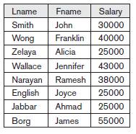
UNARY RELATIONAL OPERATIONS(CONTD..)
RENAME OPERATOR
The Rename operator is denoted by ρ (rho).
It is used to rename the attributes of a relation or the relation name or both.
The general RENAME operation ρ can be expressed by any of the following forms:
ρS (B1, B2, …, Bn )(R) changes both:
the relation name to S, and the column (attribute) names to B1, B1, …..Bn
ρS(R) changes: the relation name only to S
ρ(B1, B2, …, Bn )(R) changes: the column (attribute) names only to B1, B1, …..Bn

Slide 44
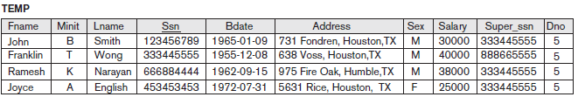
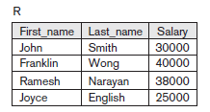
UNARY RELATIONAL OPERATIONS(CONTD..)
Example of Rename operation
To rename the attributes in a relation, simply list the new attribute names in parentheses, as in the following example:
TEMP ← σ DNO = 5 (EMPLOYEE)
R (First_Name, Last_Name, Salary)← π FNAME, LNAME, SALARY (TEMP)

Slide 45
RELATIONAL ALGEBRA OPERATIONS FROM SET THEORY
UNION OPERATION
1. Binary operation, denoted by ∪.
2. The result of R ∪ S is a relation that includes all tuples that are either in R or in S or in both R and S.
3. Duplicate tuples are eliminated.
4. The two operand relations R and S must be type compatible(or UNION compatible):
R and S must have same number of attributes.
Each pair of corresponding attributes must be type compatible ( have same domains).

Slide 46
RELATIONAL ALGEBRA OPERATIONS FROM SET THEORY (CONTD..)
INTERSECTION OPERATION
1. INTERSECTION is denoted by ∩.
2. The result of the operation R ∩ S, is a relation that includes all tuples that are common to both R and S.
3. The attribute names in the result will be the same as the attribute names in R.
4. The two operand relations R and S must be ―type compatible.
SET DIFFERENCE
1. SET DIFFERENCE (also called MINUS or EXCEPT) is denoted by –
2. The result of R – S, is a relation that includes all tuples that are in R but not in S
3. The attribute names in the result will be the same as the attribute names in R
4. The two operand relations R and S must be―type compatible

Slide 47
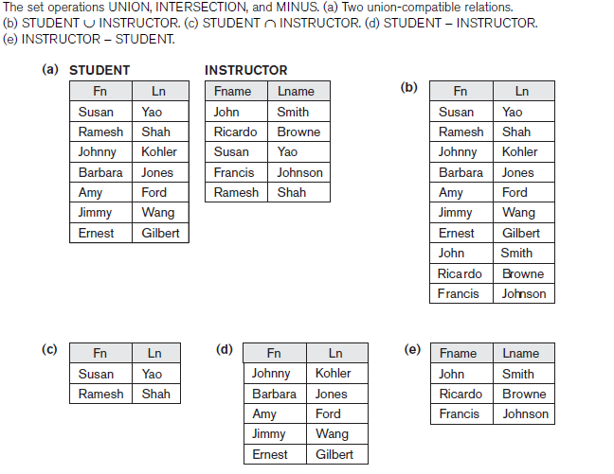
RELATIONAL ALGEBRA OPERATIONS FROM SET THEORY (CONTD..)
Example of union, intersection and set difference operations

Slide 48
RELATIONAL ALGEBRA OPERATIONS FROM SET THEORY (CONT.)
Notice that both union and intersection are commutative operations; that is
R ∪ S = S ∪ R, and R ∩ S = S ∩ R
Both union and intersection can be treated as n-ary operations applicable to any number of relations as both are associative operations; that is
R ∪ (S ∪ T) = (R ∪ S) ∪ T, and (R ∩ S) ∩ T = R ∩ (S ∩ T)
The minus operation is not commutative; that is, in general
R - S ≠ S – R

Slide 49
RELATIONAL ALGEBRA OPERATIONS FROM SET THEORY (CONT.)
CARTESIAN (OR CROSS) PRODUCT OPERATION
1. This operation is used to combine tuples from two relations in a combinatorial fashion.
2. Denoted by R(A1, A2, . . ., An) x S(B1, B2, . . ., Bm).
3. Result is a relation Q with degree n + m attributes: Q(A1, A2, . . ., An, B1, B2, . . ., Bm), in that order.
4. The resulting relation state has one tuple for each combination of tuples—one from R and one from S.
5. Hence, if R has nR tuples and S has nS tuples, then R x S will have nR * nS tuples.
6. The two operands do NOT have to be "type compatible”.

Slide 50
RELATIONAL ALGEBRA OPERATIONS FROM SET THEORY (CONT.)
7. Example:
FEMALE_EMPS ← σ SEX=’F’(EMPLOYEE)
EMPNAMES ← π FNAME, LNAME, SSN (FEMALE_EMPS)
EMP_DEPENDENTS ← EMPNAMES x DEPENDENT
8. EMP_DEPENDENTS will contain every combination of EMPNAMES and DEPENDENT

Slide 51
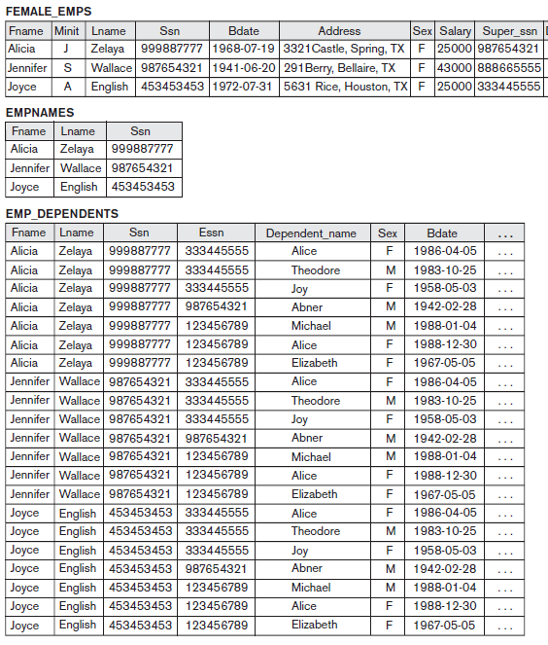
RELATIONAL ALGEBRA OPERATIONS FROM SET THEORY (CONT.)

Slide 52
RELATIONAL ALGEBRA OPERATIONS FROM SET THEORY (CONT.)
Binary Relational Operations
JOIN Operation
The sequence of cartesian product followed by select is used quite commonly to identify and select related tuples from two relations, a special operation, called JOIN. It is denoted by a
This operation is very important for any relational database with more than a single relation, because it allows us to process relationships among relations.
The general form of a join operation on two relations R(A₁, A₂, . . ., A_{n}) and S(B₁, B₂, . . ., B_{m}) is:
R _{<join condition>}S
where R and S can be any relations that result from general relational algebra expressions.

Slide 53
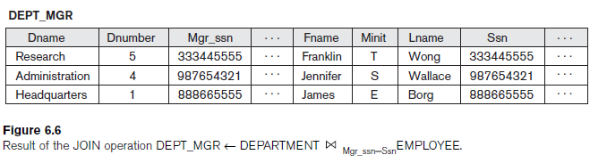
RELATIONAL ALGEBRA OPERATIONS FROM SET THEORY (CONT.)
Example: Suppose that we want to retrieve the name of the manager of each department. To get the manager’s name, we need to combine each DEPARTMENT tuple with the EMPLOYEE tuple whose SSN value matches the MGRSSN value in the department tuple. We do this by using the join operation.
DEPT_MGR ← DEPARTMENT _{MGR_SSN=SSN} EMPLOYEE

Slide 54
RELATIONAL ALGEBRA OPERATIONS FROM SET THEORY (CONT.)
EQUIJOIN Operation
The most common use of join involves join conditions with equality comparisons only. Such a join, where the only comparison operator used is =, is called an EQUIJOIN.
NATURAL JOIN Operation
Because one of each pair of attributes with identical values is superfluous, a new operation called natural join denoted by *was created to get rid of the second (superfluous) attribute in an EQUIJOIN condition.

Slide 55
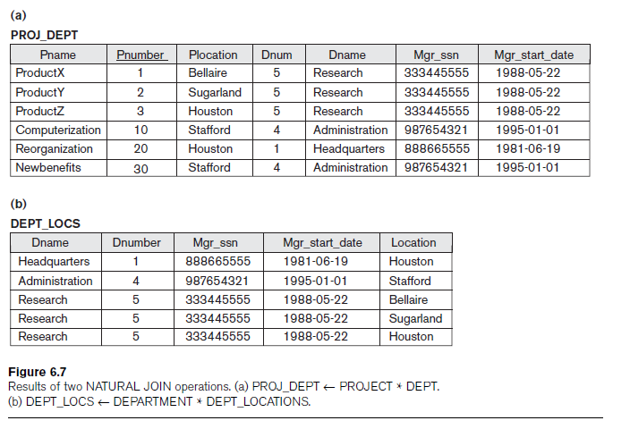
RELATIONAL ALGEBRA OPERATIONS FROM SET THEORY (CONT.)
Example: To apply a natural join on the DNUMBER attributes of DEPARTMENT and DEPT_LOCATIONS, it is sufficient to write:
DEPT_LOCS ← DEPARTMENT *DEPT_LOCATIONS

Slide 56
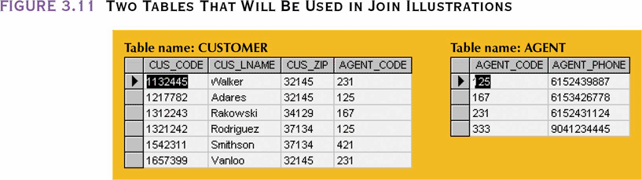
RELATIONAL ALGEBRA OPERATIONS FROM SET THEORY (CONT.)
OUTER JOIN
Matched pairs are retained and any unmatched values in other table are left null
In outer join for tables CUSTOMER and AGENT, two scenarios are possible:

Slide 57
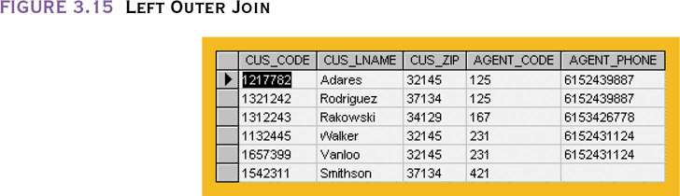
RELATIONAL ALGEBRA OPERATIONS FROM SET THEORY (CONT.)
Left outer join
Yields all rows in CUSTOMER table, including those that do not have a matching value in the AGENT table

Slide 58
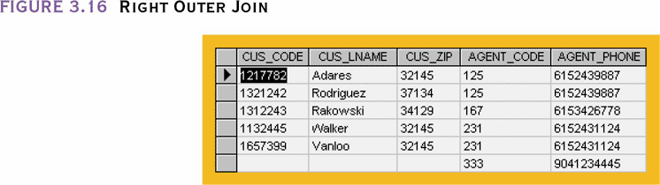
RELATIONAL ALGEBRA OPERATIONS FROM SET THEORY (CONT.)
Right outer join
Yields all rows in AGENT table, including those that do not have matching values in the CUSTOMER table

Slide 59
RELATIONAL ALGEBRA OPERATIONS FROM SET THEORY (CONT.)
DIVISION OPERATION
The DIVISION operation, denoted by ÷, is useful for a special kind of query that sometimes occurs in database applications.
An example is Retrieve the names of employees who work on all the projects that ‘John Smith’ works on
First, retrieve the list of project numbers that ‘John Smith’ works on in the intermediate relation SMITH_PNOS:
SMITH ← σ Fname=‘John’ AND Lname = ‘Smith’ (EMPLOYEE)
SMITH_PNOS ← πPno(WORKS_ON Essn=SsnSMITH)
Next, create a relation that includes a tuple <Pno, Essn> whenever the employee whose Ssn is Essn works on the project whose number is Pno in the intermediate relation SSN_PNOS:
SSN_PNOS ← πEssn, Pno(WORKS_ON)

Slide 60
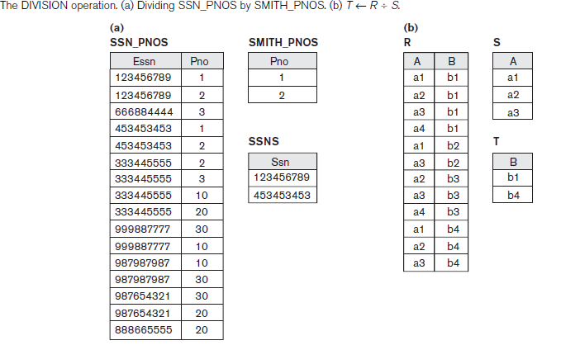
RELATIONAL ALGEBRA OPERATIONS FROM SET THEORY (CONT.)
Finally, apply the DIVISION operation to the two relations, which gives the desired employees’ Social Security numbers:
SSNS(Ssn) ← SSN_PNOS ÷ SMITH_PNOS
RESULT ← πFname, Lname(SSNS * EMPLOYEE)

Slide 61
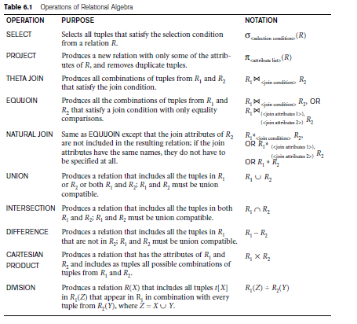

Slide 62
RELATIONAL CALCULUS
Relational calculus is a non procedural query language.
It uses mathematical predicate calculus instead of algebra.
It provides the description about the query to get the result where as relational algebra gives the method to get the result.
It informs the system what to do with the relation, but does not inform how to perform it.
For example, steps involved in listing all the students who attend ‘Database’ Course in relational algebra would be
SELECT the tuples from COURSE relation with COURSE_NAME = ‘DATABASE’
PROJECT the COURSE_ID from above result
SELECT the tuples from STUDENT relation with COUSE_ID resulted above.
In the case of relational calculus, it is described as below:
Get all the details of the students such that each student have course as 'Database'.

Slide 63
RELATIONAL CALCULUS
There are two types of relational calculus - Tuple Relational Calculus (TRC) and Domain Relational Calculus (DRC).

Slide 64
Tuple Relational Calculus (TRC)
A tuple relational calculus is a non procedural query language which specifies to select the tuples in a relation. It can select the tuples with range of values or tuples for certain attribute values etc. The resulting relation can have one or more tuples. It is denoted as below:
{t | P (t)} or {t | condition (t)} -- this is also known as expression of relational calculus
Where t is the resulting tuples, P(t) is the condition used to fetch t.
{t | EMPLOYEE (t) and t.SALARY>10000} - implies that it selects the tuples from EMPLOYEE relation such that resulting employee tuples will have salary greater than 10000. It is example of selecting a range of values.
{t | EMPLOYEE (t) AND t.DEPT_ID = 10} – this select all the tuples of employee name who work for Department 10.

Slide 65
Domain Relational Calculus (DRC)
In contrast to tuple relational calculus, domain relational calculus uses list of attribute to be selected from the relation based on the condition. It is same as TRC, but differs by selecting the attributes rather than selecting whole tuples. It is denoted as below:
{< a₁, a₂, a₃, … a_{n} > | P(a₁, a₂, a₃, … a_{n})}
Where a₁, a₂, a₃, … a_{n} are attributes of the relation and P is the condition.
For example, select EMP_ID and EMP_NAME of employees who work for department 10
{<EMP_ID, EMP_NAME> | <EMP_ID, EMP_NAME> ? EMPLOYEE Λ DEPT_ID = 10}
Get name of the department name that Alex works for.
{DEPT_NAME |< DEPT_NAME > ? DEPT Λ ? DEPT_ID (<DEPT_ID> ? EMPLOYEE Λ EMP_NAME = Alex)}

Slide 66
RELATIONAL DATABASE BASIC CONCEPTS
Relations or Tables
In Relational database, a table is a collection of data elements organized in terms of rows and columns.
A table is also considered as convenient representation of relations.
Table is the most simplest form of data storage.
Base and Derived relations
Relations that store data are called "base relations", and in implementations are called "tables“.
Relations that do not store data, but are computed by applying relational operations to other relations called "derived relations“, and In implementations these are called "views" or "queries“.

Slide 67
RELATIONAL DATABASE BASIC CONCEPTS(CONTD..)
TUPLE/RECORD/ROW
A single entry in a table is called a Record or Row. A Record in a table represents set of related data.
FIELD/COLUMN
Every table is broken up into smaller entities called fields. The fields in the CUSTOMERS table consist of ID, NAME, AGE, ADDRESS and SALARY.
A field is a column in a table that is designed to maintain specific information about every record in the table.
DOMAIN
A domain describes the set of possible values for a given attribute, and can be considered a constraint on the value of the attribute.

Slide 68
RELATIONAL DATABASE BASIC CONCEPTS(CONTD..)
CONSTRAINTS
Constraints make it possible to further restrict the domain of an attribute.
For instance, a constraint can restrict a given integer attribute to values between 1 and 10.
Constraints provide one method of implementing business rules in the database.
DATA TYPE
Each of a table's columns has a defined datatype that specifies the type of data that can exist in that column.
For example, the FirstName column might be defined as varchar(20), indicating that it can contain a string of up to 20 characters.

Slide 69
RELATIONAL DATABASE BASIC CONCEPTS(CONTD..)
PRIMARY KEY
Primary key is the column (or set of columns) which values uniquely identify the row. All primary key fields have a different value in a specific table. A table should have a primary key.
Key that consist of two or more attributes that uniquely identify an entity occurrence is called Composite key.
FOREIGN KEY
Foreign key columns are columns that link to primary key columns in other tables, thereby creating a relationship.

Slide 70
RELATIONAL DATABASE BASIC CONCEPTS(CONTD..)
INDEX
An index is one way of providing quicker access to data. Indices can be created on any combination of attributes on a relation.
Queries that filter using those attributes can find matching tuples randomly using the index, without having to check each tuple in turn.
This is analogous to using the index of a book to go directly to the page on which the information you are looking for is found, so that you do not have to read the entire book to find what you are looking for.

Slide 71
DB INTEGRITY
DOMAIN INTEGRITY
Property that the value of an attribute conforms to the domain defined for the attribute.
ENTITY INTEGRITY
Primary keys must be unique and no null values are allowed in any part of a primary key.
REFERENTIAL INTEGRITY
Referential integrity is said to exist when a foreign key has a matching primary key in another relation.
Said another way, referential integrity means that if the foreign key contains a value, that value refers to an existing valid tuple in another relation.

Slide 72
CODD’S RULE
RULE | RULE NAME | DESCRIPTION
Rule1 | Information rule | All information is represented logically by values in tables
Rule 2 | Guaranteed Access Rule | Every data value is logically accessible by a combination of table name, primary key value and column name.
Rule 3 | Missing Information rule | Null values are systematically supported independent of data type.
Rule 4 | System catalogue Rule | The logical description of the database is represented and may be interrogated by authorized users.
Rule 5 | Comprehensive language Rule | A high level relational language that support all of the following: data definition, view definition, data manipulation, integrity constraints, authorization, transaction boundaries.

Slide 73
CODD’S RULE(CONTD..)
Rule 6 | View update rule | The system should able to perform all theoretically possible updates on view.
Rule 7 | Set level Update Rule | The ability to treat whole table as single object applies to insertion, modification and deletion, as well as retrieval of data.
Rule 8 | Physical data independence rule | User operations and application program should be independent of any changes in physical storage.
Rule 9 | Logical data independence rule | User operations and application program should be independent of any changes in Logical structure of base table provided they involve no loss of information
Rule 10 | Integrity independence rule | Entity and referential integrity constraints should be defined in the high level relational language, not by application programs.

Slide 74
CODD’S RULE(CONTD..)
Rule 11 | Distribution independence rule | User operations and application program should be independent of location of data when it is distributed over multiple computers.
Rule 12 | Non-subversion rule | If a low-level procedural language is supported, it must not able to subvert integrity or security constraints expressed in the high-level relational language

Slide 75
Database Model
High level or Conceptual Model
Representational Model
Implementation Model

Slide 76
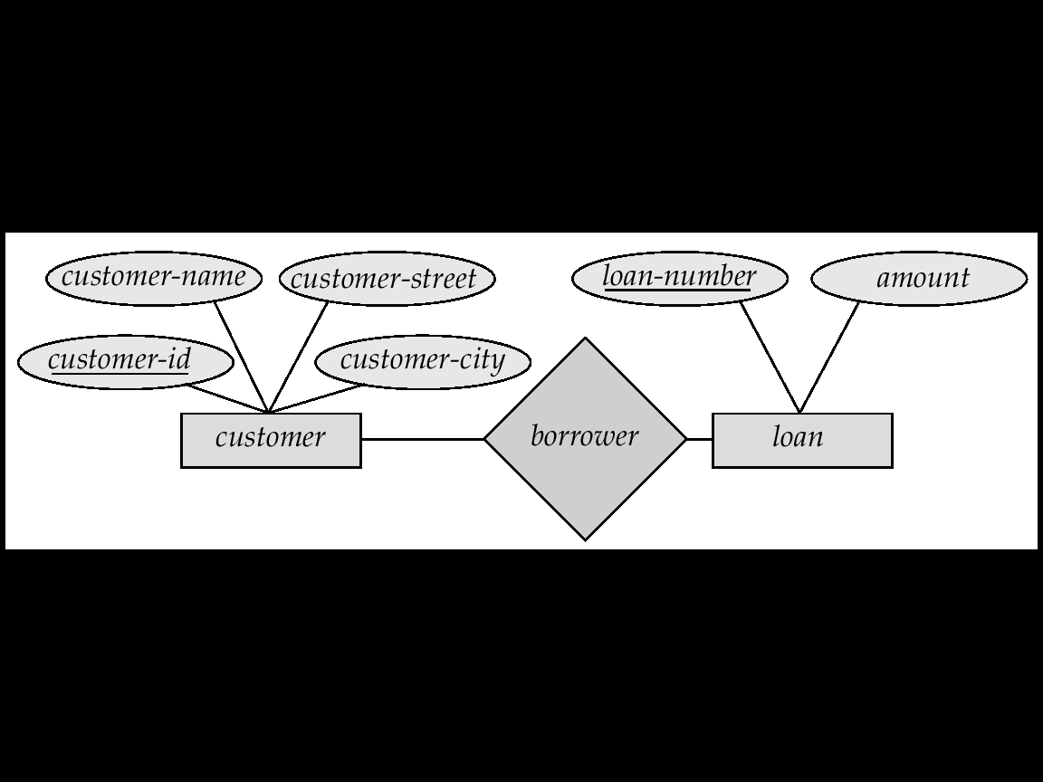
Entity Relationship Diagram

Slide 77
ENTITY RELATIONSHIP MODEL
The ER model defines the conceptual view of a database. It works around real-world entities and the associations among them.
At view level, the ER model is considered a good option for designing databases.
The E-R data model employs three basic notations:
Entity sets
Relationship sets
Attributes.

Slide 78
ENTITY RELATIONSHIP MODEL(CONTD..)
ENTITY
An entity can be a real-world object, either animate or inanimate, that can be easily identifiable. For example, in a school database, students, teachers, classes, and courses offered can be considered as entities. All these entities have some attributes or properties that give them their identity.
An entity set is a collection of similar types of entities. An entity set may contain entities with attribute sharing similar values. For example, a Students set may contain all the students of a school; likewise a Teachers set may contain all the teachers of a school from all faculties. Entity sets need not be disjoint.

Slide 79
ENTITY RELATIONSHIP MODEL(CONTD..)
ATTRIBUTES
Entities are represented by means of their properties, called attributes. All attributes have values.
For example, a student entity may have name, class, and age as attributes.
There exists a domain or range of values that can be assigned to attributes.
For example, a student's name cannot be a numeric value. It has to be alphabetic. A student's age cannot be negative, etc.

Slide 80
ENTITY RELATIONSHIP MODEL(CONTD..)
TYPES OF ATTRIBUTES
Simple attribute − Simple attributes are atomic values, which cannot be divided further.
For example, a student's phone number is an atomic value of 10 digits.
Composite attribute − Composite attributes are made of more than one simple attribute.
For example, a student's complete name may have first_name and last_name.
Derived attribute − Derived attributes are the attributes that do not exist in the physical database, but their values are derived from other attributes present in the database.

Slide 81
ENTITY RELATIONSHIP MODEL(CONTD..)
For example, average_salary in a department should not be saved directly in the database, instead it can be derived. For another example, age can be derived from data_of_birth.
Single-value attribute − Single-value attributes contain single value.
For example −Social_Security_Number.
Multi-value attribute − Multi-value attributes may contain more than one values.
For example, a person can have more than one phone number, email_address, etc.

Slide 82
ENTITY RELATIONSHIP MODEL(CONTD..)
These attribute types can come together in a way like −
simple single-valued attributes
simple multi-valued attributes
composite single-valued attributes
composite multi-valued attributes
Entity-Set and Keys
Key is an attribute or collection of attributes that uniquely identifies an entity among entity set.
For example, the roll_number of a student makes him/her identifiable among students.

Slide 83
ENTITY RELATIONSHIP MODEL(CONTD..)
Super Key − A set of attributes one or more that collectively identifies an entity in an entity set.
Candidate Key − A minimal super key is called a candidate key. An entity set may have more than one candidate key.
Primary Key − A primary key is one of the candidate keys chosen by the database designer to uniquely identify the entity set.
Relationship
The association among entities is called a relationship. For example, an employee works_at a department, a student enrolls in a course. Here, Works_at and Enrolls are called relationships.

Slide 84
ENTITY RELATIONSHIP MODEL(CONTD..)
RELATIONSHIP SET
A set of relationships of similar type is called a relationship set. Like entities, a relationship too can have attributes. These attributes are called descriptive attributes.
DEGREE OF RELATIONSHIP
The number of participating entities in a relationship defines the degree of the relationship.
Binary = degree 2
Ternary = degree 3
n-ary = degree

Slide 85
ENTITY RELATIONSHIP MODEL(CONTD..)
TYPES OF RELATIONSHIPS
Unary Relationships
A unary relationship exits when an association is maintained within a single entity.
For example, boss and worker distinguish the two employees participating in the manage association as shown in following figure
Boss
Employee
Manager
Worker

Slide 86
ENTITY RELATIONSHIP MODEL(CONTD..)
Binary relationship
A binary relationship exists when two entities are associated.
For example, the Book – Publisher relationship shown in Fig is a binary relationship.
ppppppp
Book
Publisher
Publishes

Slide 87
ENTITY RELATIONSHIP MODEL(CONTD..)
Ternary relationship
A ternary relationship exists when there are three entities associated.
Teacher
Subject
Teaches
Student

Slide 88
ENTITY RELATIONSHIP MODEL(CONTD..)
QUATERNARY RELATIONSHIP
A quaternary relationship exits when there are four entities associated.
Teacher
Student
Studies
Course material
Subject

Slide 89
ENTITY RELATIONSHIP MODEL(CONTD..)
CONSTRAINTS
An E-R enterprise schema may define certain constraints to which the contents of a database system must conform.
To main important types of constraints are:
Mapping cardinalities
Participation constraints

Slide 90
ENTITY RELATIONSHIP MODEL(CONTD..)
MAPPING CARDINALITIES
Cardinality defines the number of entities in one entity set, which can be associated with the number of entities of other set via relationship set.

Slide 91
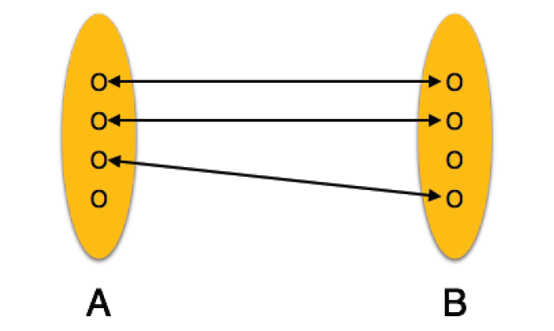
ENTITY RELATIONSHIP MODEL(CONTD..)
One-to-one − One entity from entity set A can be associated with at most one entity of entity set B and vice versa.
ppppppp
Account
Customer
Depositor

Slide 92
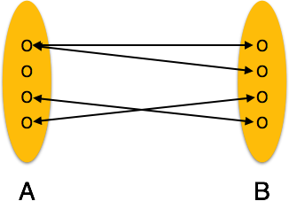
ENTITY RELATIONSHIP MODEL(CONTD..)
One-to-many − One entity from entity set A can be associated with more than one entities of entity set B however an entity from entity set B, can be associated with at most one entity.
ppppppp
Account
Customer
Depositor

Slide 93
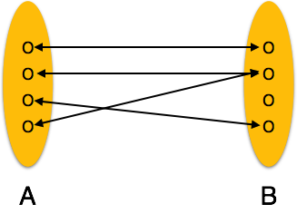
ENTITY RELATIONSHIP MODEL(CONTD..)
Many-to-one − More than one entities from entity set A can be associated with at most one entity of entity set B, however an entity from entity set B can be associated with more than one entity from entity set A.
ppppppp
Company
Employees
Works- for

Slide 94
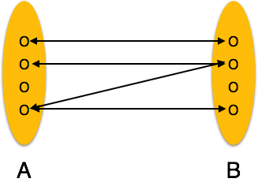
ENTITY RELATIONSHIP MODEL(CONTD..)
Many-to-many − One entity from A can be associated with more than one entity from B and vice versa.
ppppppp
Project
Employee
Works- on

Slide 95
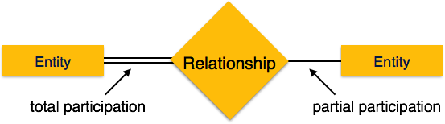
ENTITY RELATIONSHIP MODEL(CONTD..)
PARTICIPATION CONSTRAINTS
Total Participation − Each entity is involved in the relationship. Total participation is represented by double lines.
Partial participation − Not all entities are involved in the relationship. Partial participation is represented by single lines.

Slide 96
Entity Relationship Diagram

Slide 97
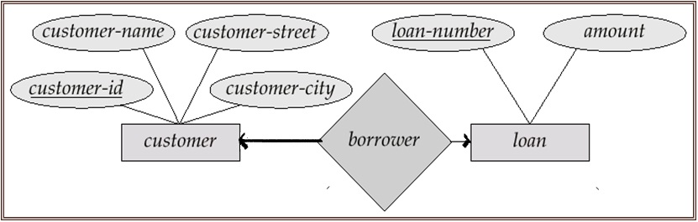
Cardinality Constraints
We express cardinality constraints by drawing either a directed line (→), signifying “one,” or an undirected line (—), signifying “many,” between the relationship set and the entity set.
One-to-one relationship:
A customer is associated with at most one loan via the relationship borrower
A loan is associated with at most one customer via borrower

Slide 98
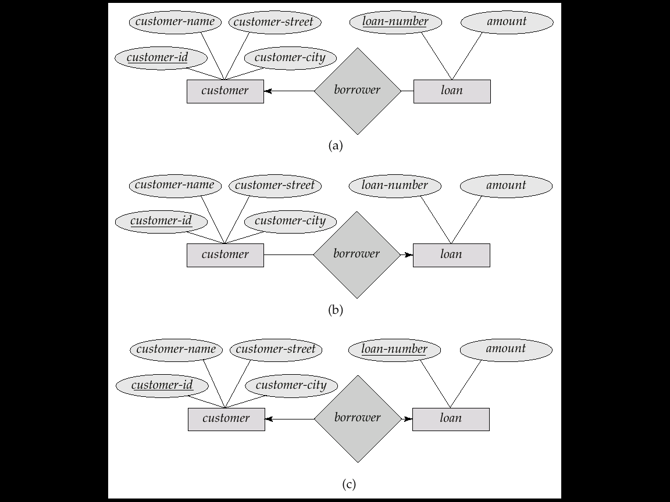
Cardinality Constraints(contd..)
one-to-many relationship
In the one-to-many relationship a loan is associated with at most one customer via borrower, a customer is associated with several (including 0) loans via borrower

Slide 99
Cardinality Constraints(contd..)
Many-to-one relationship
In a many-to-one relationship a loan is associated with several (including 0) customers via borrower, a customer is associated with at most one loan via borrower

Slide 100
Cardinality Constraints(contd..)
Many-To-Many Relationship
A customer is associated with several (possibly 0) loans via borrower
A loan is associated with several (possibly 0) customers via borrower

Slide 101
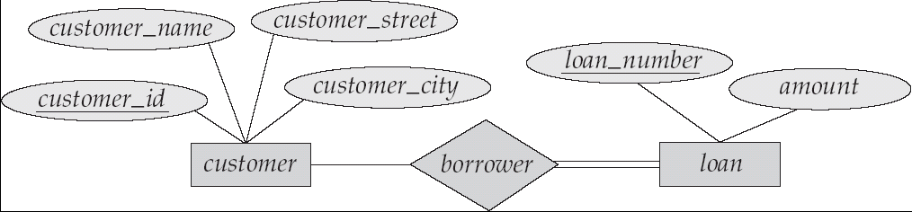
Cardinality Constraints(contd..)
Participation of an Entity Set in a Relationship Set
Total participation (indicated by double line): every entity in the entity set participates in at least one relationship in the relationship set
E.g. participation of loan in borrower is total
every loan must have a customer associated to it via borrower
Partial participation: some entities may not participate in any relationship in the relationship set
Example: participation of customer in borrower is partial

Slide 102
Dependency
Existence Dependency
If the existence of entity X depends on the existence of entity Y, then X is said to be existence dependent on Y.
An entity that is existence dependent on some other entity is called weak entity set.
An entity set on which weak entity set depends is called strong entity set.
Loan_Pmt
Payments
Loans
lno
lamt
pno
pdate
pamt
Weak Entity Set
Identifying Relationship

Slide 103
EXTENDED E-R MODEL
The E-R model that is supported with additional semantic concepts is called extended entity relationship model or EER model.
The EER model includes all the concepts of the original E-R model together with the following additional concepts:
Specialization
Generalization
Aggregation

Slide 104
SPECIALIZATION
Specialization is the process of designating subgroupings within an entity set.
Specialization is a top-down process.
Depicted by a triangle component labeled ISA (E.g. customer “is a” person).
The ISA relationship also referred to as superclass - subclass relationship

Slide 105
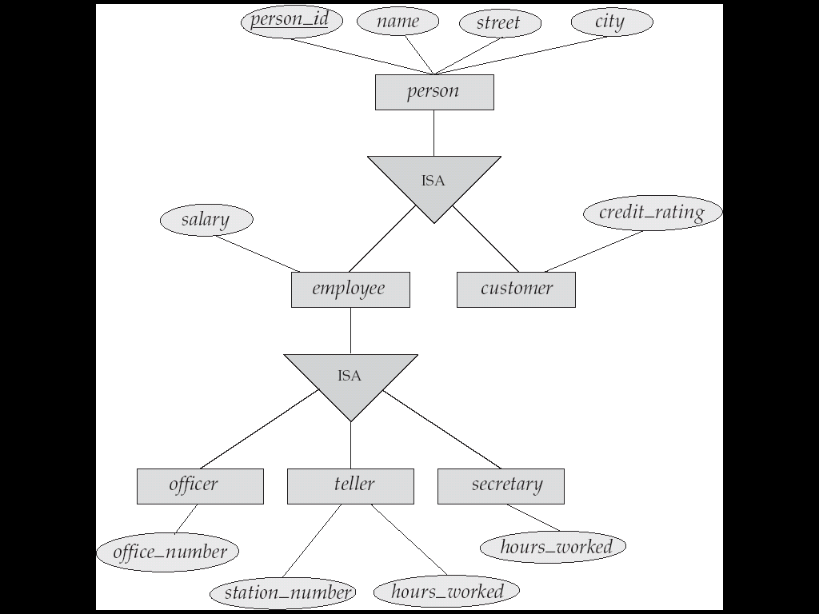
SPECIALIZATION(CONTD..)

Slide 106
Generalization
Generalization is the process of defining a more general entity type from a set of more specialized entity types.
It is bottom-up approach. This approach results in the identification of a generalized superclass from the original subclasses
Specialization and generalization are simple inversions of each other; they are represented in an E-R diagram in the same way.
Example: CAR, TRUCK generalized into VEHICLE; both CAR, TRUCK become subclasses of the superclass VEHICLE.
We can view {CAR, TRUCK} as a specialization of VEHICLE
Alternatively, we can view VEHICLE as a generalization of CAR and TRUCK

Slide 107
GENERALIZATION CONSTRAINTS
One type of constraint involves determining which entities can be members of a given lower-level entity set.
CONDITION-DEFINED:
In condition-deﬁned lower-level entity sets, membership is evaluated on the basis of whether or not an entity satisﬁes an explicit condition or predicate
Example:Assume that the higher-level entity set account has the attribute account-type. All account entities are evaluated on the deﬁning account-type attribute. Only those entities that satisfy the condition account-type = “savings account” are allowed to belong to the lower-level entity set person. All entities that satisfy the condition account-type = “checking account” are included in checking account.

Slide 108
GENERALIZATION CONSTRAINTS(CONTD..)
since all the lower-level entities are evaluated on the basis of the same attribute (in this case, on account-type), this type of generalization is said to be attribute-deﬁned.
USER-DEFINED:
User-deﬁned lower-level entity sets are not constrained by a membership condition; rather, the database user assigns entities to a given entity set.

Slide 109
GENERALIZATION CONSTRAINTS(CONTD..)
Example: Assume that, after 3 months of employment, bank employees are assigned to one of four work teams. We therefore represent the teams as four lower-level entity sets of the higher-level employee entity set. A given employee is not assigned to a speciﬁc team entity automatically on the basis of an explicit deﬁning condition. Instead, the user in charge of this decision makes the team assignment on an individual basis. The assignment is implemented by an operation that adds an entity to an entity set.

Slide 110
GENERALIZATION CONSTRAINTS(CONTD..)
A second type of constraint relates to whether or not entities may belong to more than one lower-level entity set within a single generalization. The lower-level entity sets may be one of the following:
DISJOINT:
A disjointness constraint requires that an entity belong to no more than one lower-level entity set.
Example: An account entity can satisfy only one condition for the account-type attribute; an entity can be either a savings account or a checking account, but cannot be both.

Slide 111
GENERALIZATION CONSTRAINTS(CONTD..)
OVERLAPPING:
In overlapping generalizations, the same entity may belong to more than one lower-level entity set within a single generalization.
Example: Consider the employee work team example, and assume that certain managers participate in more than one work team. A given employee may therefore appear in more than one of the team entity sets that are lower-level entity sets of employee. Thus, the generalization is overlapping.

Slide 112
GENERALIZATION CONSTRAINTS(CONTD..)
A ﬁnal constraint, the completeness constraint on a generalization or specialization, speciﬁes whether or not an entity in the higher-level entity set must belong to at least one of the lower-level entity sets within the generalization/specialization. This constraint may be one of the following:
TOTAL GENERALIZATION OR SPECIALIZATION: Each higher-level entity must belong to a lower-level entity set.
PARTIAL GENERALIZATION OR SPECIALIZATION: Some higher-level entities may not belong to any lower-level entity set.

Slide 113
ATTRIBUTE INHERITANCE
A crucial property of the higher- and lower-level entities created by specialization and generalization is attribute inheritance.
The attributes of the higher-level entity sets are said to be inherited by the lower-level entity sets.
Example: Customer and employee inherit the attributes of person. Thus, customer is described by its name, street, and city attributes, and additionally a customer-id attribute; employee is described by its name, street, and city attributes, and additionally employee-id and salary attributes.

Slide 114
AGGREGATION
Aggregation is an abstraction through which relationships are treated as higher- level entities.
Example, we regard the relationship set works-on (relating the entity sets employee, branch, and job) as a higher-level entity set called works-on. Such an entity set is treated in the same manner as is any other entity set. We can then create a binary relationship manages between works-on and manager to represent who manages what tasks.

Slide 115
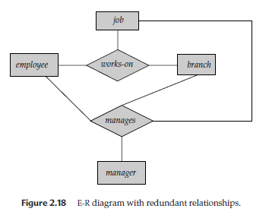
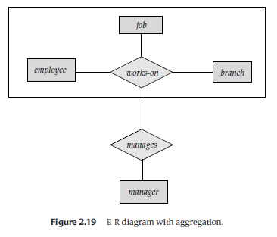
AGGREGATION(CONTD..)

Slide 116
FUNCTIONAL DEPENDENCIES
Functional dependency (FD) is a set of constraints between two attributes in a relation.
Functional dependency says that if two tuples have same values for attributes A1, A2,..., An, then those two tuples must have to have same values for attributes B1, B2, ..., Bn.
Functional dependency is represented by an arrow sign (→) that is, X→Y, where X functionally determines Y.
The left-hand side attributes determine the values of attributes on the right-hand side.

Slide 117
INFERENCE RULES FOR FUNCTIONAL DEPENDENCY:
Let's take X, Y and Z such that X, Y, Z, W ⊆ R. 1. Reflexive Rule: X⊆Y then Y→ X . Example: For R(ABCD), ABC → AB. 2. Augmentation Rule: if X→ Y then XZ→ YZ. 3. Transitive Rule: if X→ Y and Y→ Z then X→ Z. 4. Additive / Union Rule: if X→ Y and X→ Z then X→ YZ. 5. Pseudo Transitive Rule: if X→ Y and YZ → W then XZ→W. 6. Productive/ Decomposition Rule: if X→ YZ then X→ Y and X→ Z.

Slide 118
ANOMALY
Anomalies are inconvenient or error-prone situation arising when we process the tables.
Storing natural joins of base relations leads to an additional problem referred to as update anomalies.
These are:
insertion anomalies
deletion anomalies
modification anomalies

Slide 119
ANOMALY(CONTD..)
EXAMPLE:
Consider a relation emp_dept with attributes:
E# {with the primary key as E#.}, Ename, Address, D#, Dname, Dmgr#
Insertion anomaly: Let us assume that a new department has been started by the organization but initially there is no employee appointed for that department, then the tuple for this department cannot be inserted into this table as theE# will have NULL, which is not allowed as E# is primary key.
This kind of a problem in the relation where some tuple cannot be inserted is known as insertion anomaly.

Slide 120
ANOMALY(CONTD..)
DELETION ANOMALY
Now consider there is only one employee in some department and that employee leaves the organization, then the tuple of that employee has to be deleted from the table, but in addition to that the information about the department also will get deleted.
This kind of a problem in the relation where deletion of some tuples can lead to loss of some other data not intended to be removed is known as deletion anomaly.,

Slide 121
ANOMALY(CONTD..)
MODIFICATION /UPDATE ANOMALY:
Suppose the manager of a department has changed, this requires that the Dmgr# in all the tuples corresponding to that department must be changed to reflect the new status. If we fail to update all the tuples of the given department, then two different records of employee working in the same department might show different Dmgr# leading to inconsistency in the database.
This is known as modification/update anomaly. The data redundancy can not be totally removed from the database, but there should be controlled redundancy

Slide 122
DECOMPOSITION
Decomposition – the process of breaking down in parts or elements.
Decomposition in database means breaking tables down into multiple tables
From Database perspective means going to a higher normal form
Two Characteristics of Decompositions
1) Lossless
2)Dependency Preservation

Slide 123
DECOMPOSITION(CONTD..)
LOSSLESS DECOMPOSITION
Let R be a relation schema.
Let F be a set of functional dependencies on R.
Let and form a decomposition of R.
The decomposition is a lossless-join decomposition of R if at least one of the following functional dependencies are in F⁺
1) R1 ∩ R2 → R1
2) R1 ∩ R2 → R2

Slide 124
DECOMPOSITION(CONTD..)
A decomposition is lossless if we can recover:
R(A,B,C)
R1(A,B) R2(A,C)
R’(A,B,C) should be the same as R(A,B,C)
Decompose
Recover
Must ensure R’ = R

Slide 125
DECOMPOSITION(CONTD..)
DEPENDENCY PRESERVATION
Given a relation schema R and set of functional dependencies associated with it is F
R is decomposed into the relation schemas R1,R2…Rn with functional dependencies F1,F2,…Fn. Then the decomposition is dependency preserving if the closure of F’ (where F’=F1 F2…Fn) is identical to F+ i.e.
F’+=F+

Slide 126
NORMALIZATION
Normalization is a process that “improves” a database design by generating relations that are of higher normal forms.
Normalization is used for mainly two purpose,
Eliminating redundant (useless) data.
Ensuring data dependencies make sense i.e data is logically stored.
First Normal Form (1NF)
Second Normal Form (2NF)
Third Normal Form (3NF)
Boyce-Codd Normal Form (BCNF)
Fourth Normal Form (4NF)
Fifth Normal Form (5NF)

Slide 127
Problem Without Normalization
Without Normalization, it becomes difficult to handle and update the database, without facing data loss. Insertion, Updation and Deletion Anamolies are very frequent if Database is not Normalized. To understand these anomalies let us take an example of Student table.
S_id | S_Name | S_Address | Subject_opted
401 | Adam | Noida | Bio
402 | Alex | Panipat | Maths
403 | Stuart | Jammu | Maths
404 | Stuart | Noida | Physics

Slide 128
Updation Anamoly : To update address of a student who occurs twice or more than twice in a table, we will have to update S_Address column in all the rows, else data will become inconsistent.
Insertion Anamoly : Suppose for a new admission, we have a Student id(S_id), name and address of a student but if student has not opted for any subjects yet then we have to insert NULL there, leading to Insertion Anamoly.
Deletion Anamoly : If (S_id) 401 has only one subject and temporarily he drops it, when we delete that row, entire student record will be deleted along with it.

Slide 129
FIRST NORMAL FORM (1NF)
The requirements to satisfy the 1st NF:
Each table has a primary key: minimal set of attributes which can uniquely identify a record
The values in each column of a table are atomic (No multi-value attributes allowed).
There are no repeating groups: two columns do not store similar information in the same table.

Slide 130
FIRST NORMAL FORM (1NF) (CONTD..)
Un-normalized table:
PNo PName ENo EName Jcode ChgHr Hrs
1 Alpha 101 John Doe NE $65 20
105 Jane Vo SA $80 15
110 Bob Lund CP $60 40
2 Beta 101 John Doe NE $65 20
108 Jeb Lee NE $65 15
106 Sara Lee SA $80 20
3 Omega 102 Beth Reed PM $125 20
105 Jane Vo SA $80 10
Is the above relation in 1NF?

Slide 131
FIRST NORMAL FORM (1NF) (CONTD..)
The previous relation can be converted into first normal form by adding Pno and Pname to each row.
PNo PName ENo EName Jcode ChgHr Hrs
1 Alpha 101 John Doe NE $65 20
1 Alpha 105 Jane Vo SA $80 15
1 Alpha 110 Bob Lund CP $60 40
2 Beta 101 John Doe NE $65 20
2 Beta 108 Jeb Lee NE $65 15
2 Beta 106 Sara Lee SA $80 20
3 Omega 102 Beth Reed PM $125 20
3 Omega 105 Jane Vo SA $80 10

Slide 132
SECOND NORMAL FORM
Dependency diagram for Project
PNo
PName
ENo
EName
JCode
ChgHr
Hrs

Slide 133
SECOND NORMAL FORM (2NF)
The requirements to satisfy the 2nd NF:
All requirements for 1st NF must be met.
Redundant data across multiple rows of a table must be moved to a separate table.
The resulting tables must be related to each other by use of foreign key.
We create new relations that are in 2NF through projection of the original relation.
Project(PNo, PName)
Employee(ENo, EName, Jcode, ChgHr)
Charge(PNo, ENo, Hrs)

Slide 134
SECOND NORMAL FORM (2NF)
2NF
PNo
PName
ENo
EName
JCode
ChgHr
PNo
ENo
Hrs

Slide 135
SECOND NORMAL FORM
Tables in 2NF
Charge
PNo ENo Hrs
1 101 20
1 105 15
1 110 40
2 101 20
2 108 15
2 106 20
3 102 20
3 105 10
Project
PNo PName
1 Alpha
2 Beta
3 Omega
Employee
ENo EName JCode ChgHr
101 John Doe NE $65
102 Beth Reed PM $125
105 Jane Vo SA $80
106 Sara Lee SA $80
108 Jeb Lee NE $65
110 Bob Lund CP $60

Slide 136
Third Normal Form
A relation is in 3NF if:
It is in 2NF and
every nonkey attribute is nontransitively dependent on the primary key (i.e., no transitive dependency).
Relation Employee has a transitive dependency:
ENo JCode ChgHr
Employee can be replaced by two relations, that are in 3NF:
Employee(ENo, EName, Jcode)
Job(JCode, ChgHr)
Notes:
16

Slide 137
3NF
3NF
PNo
PName
JCode
ChgHr
ENo
EName
JCode
PNo
ENo
Hrs

Slide 138
Third Normal Form
Tables in 3NF
Charge
PNo ENo Hrs
1 101 20
1 105 15
1 110 40
2 101 20
2 108 15
2 106 20
3 102 20
3 105 10
Project
PNo PName
1 Alpha
2 Beta
3 Omega
Employee
ENo EName Jcode
101 John Doe NE
102 Beth Reed PM
105 Jane Vo SA
106 Sara Lee SA
108 Jeb Lee NE
110 Bob Lund CP
Job
Jcode ChgHr
CP $60
NE $65
PM $125
SA $80

Slide 139
Boyce-Codd Normal Form
A relation is in BCNF if
every determinant is a candidate key.
A determinant is an attribute (combination of attributes) on which some other attribute is fully functionally dependent.
BCNF is a special case of 3NF.
The potential to violate BCNF may occur in a relation that:
contains two (or more) composite candidate keys,
these keys overlap and share at least one attribute.
Thus, if a table contains only one candidate key or only non-composite keys, then 3NF and BCNF are equivalent.
Notes:
18

Slide 140
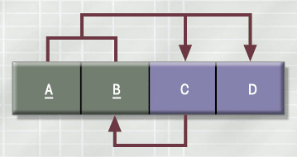
3NF Table Not in BCNF
Figure 4.7

Slide 141
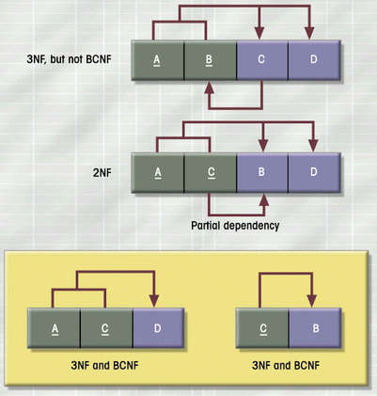
Decomposition of Table Structure to Meet BCNF
Figure 4.8

Slide 142
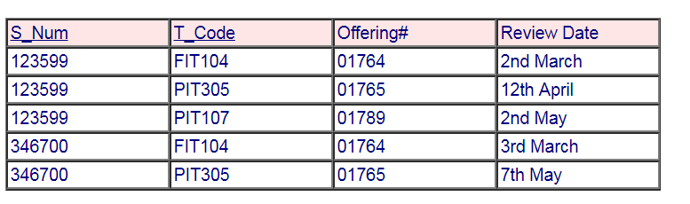
Boyce-Codd Normal Form
An example table from the University Database might be as follows:
If we know the Student Number and Teacher Code we know the Offering (class) the student is in. We also know the review date for that student and teacher (Student progress is reviewed for that class by the teacher and student).

Slide 143
Boyce-Codd Normal Form
The dependencies are S_Num, T_Code ->Offering#, Review Date which means that the table is in third normal form. The table is not in BCNF as if we know the offering number we know who the teacher is. Each offering can only have one teacher! Offering# ->T_Code A non key attribute is a determinant.
If we look at the table we can see a combination of T_Code and Offering# is repeated several times. eg FIT104 and 01764.

Slide 144
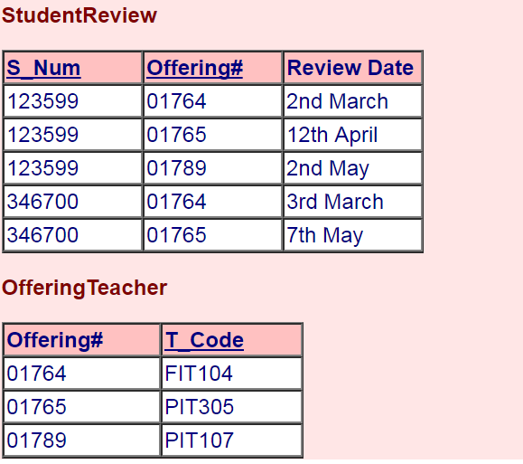
Boyce-Codd Normal Form

Slide 145
Dependency Diagram
Fig 1
CID | IDate | ITime | StaffID | RmNo
Fig 2
CID | IDate | ITime | StaffID | RmNo
Fig 3
CID | IDate | ITime | StaffID | RmNo

Slide 146
FOURTH AND FIFTH NORMAL FORMS
Fourth and fifth normal forms deal with multi-valued facts. The multi-valued fact may correspond to a many-to-many relationship, as with employees and skills, or to a many-to-one relationship, as with the children of an employee (assuming only one parent is an employee). By "many-to-many" we mean that an employee may have several skills, and a skill may belong to several employees.
the many-to-one relationship between children and fathers is a single-valued fact about a child but a multi-valued fact about a father.
In a sense, fourth and fifth normal forms are also about composite keys. These normal forms attempt to minimize the number of fields involved in a composite key.

Slide 147
Fourth Normal Form
In the fourth normal form,
It should meet all the requirement of 3NF
Attribute of one or more rows in the table should not result in more than one rows of the same table leading to multi-valued dependencies
Notes:
30

Slide 148
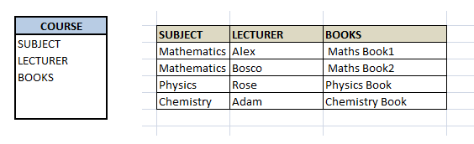
Fourth Normal Form
To understand it clearly, consider a table with Subject, Lecturer who teaches each subject and recommended Books for each subject.

Slide 149
Fourth Normal Form
LECTURER and BOOKS are two independent entities here.
There is no relationship between Lecturer and Books. In the above example, either Alex or Bosco can teach Mathematics. For Mathematics subject , student can refer either 'Maths Book1' or 'Maths Book2'. i.e.;
SUBJECT --> LECTURER
SUBJECT-->BOOKS
This is a multivalued dependency on SUBJECT.
If we need to select both lecturer and books recommended for any of the subject, it will show up (lecturer, books) combination, which implies lecturer who recommends which book. This is not correct.
SELECT c.LECTURER, c.BOOKS FROM COURSE c WHERE SUBJECT = 'Mathematics';

Slide 150
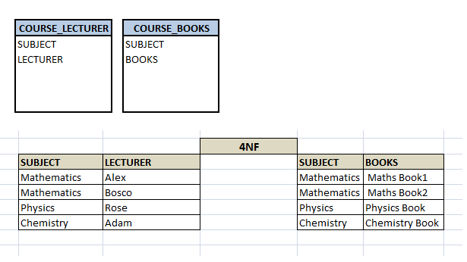
Fourth Normal Form

Slide 151
FIFTH NORMAL FORM
A database is said to be in 5NF, if and only if,
It's in 4NF
If we can decompose table further to eliminate redundancy and anomaly, and when we re-join the decomposed tables by means of candidate keys, we should not be losing the original data or any new record set should not arise. In simple words, joining two or more decomposed table should not lose records nor create new records.

Slide 152
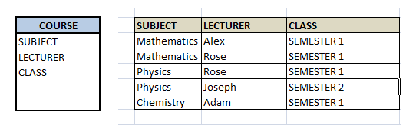
FIFTH NORMAL FORM (CONTD..)
Consider an example of different Subjects taught by different lecturers and the lecturers taking classes for different semesters.

Slide 153
FIFTH NORMAL FORM (CONTD..)
In above table, Rose takes both Mathematics and Physics class for Semester 1, but she does not take Physics class for Semester 2.
In this case, combination of all these 3 fields is required to identify a valid data. Imagine we want to add a new class - Semester3 but do not know which Subject and who will be taking that subject. We would be simply inserting a new entry with Class as Semester3 and leaving Lecturer and subject as NULL.
It's not a good to have such entries. Moreover, all the three columns together act as a primary key, we cannot leave other two columns blank!

Slide 154
FIFTH NORMAL FORM (CONTD..)
We have to decompose the table in such a way that it satisfies all the rules till 4NF and when join them by using keys, it should yield correct record.
Here, we can represent each lecturer's Subject area and their classes in a better way. We can divide above table into three - (SUBJECT, LECTURER), (LECTURER, CLASS), (SUBJECT, CLASS)

Slide 155
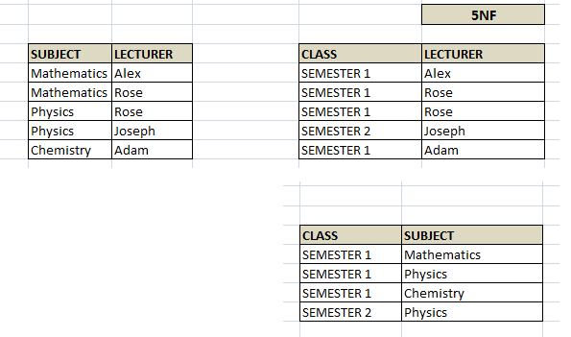
FIFTH NORMAL FORM (CONTD..)

Slide 156
For example, who teaches Physics to Semester 1, we would be selecting Physics and Semester1 from table 3 above, join with table1 using Subject to filter out the lecturer names. Then join with table2 using Lecturer to get correct lecturer name.

Slide 157
Domain Key Normal Form
Domain-key normal form (DK/NF) is a normal form used in database normalization which requires that the database contains no constraints other than domain constraints and key constraints.
A domain constraint specifies the permissible values for a given attribute, while a key constraint specifies the attributes that uniquely identify a row in a given table.
The third normal form, Boyce–Codd normal form, fourth normal form and fifth normal form are special cases of the domain/key normal form.
All have either functional, multi-valued or join dependencies that can be converted into (super)keys.

Slide 158
DOMAIN KEY NORMAL FORM(CONTD..)
The domains on those normal forms were unconstrained so all domain constraints are satisfied.
Transforming a higher normal form into domain/key normal form is not always a dependency-preserving transformation and therefore not always possible.
Wealthy person
Wealthy Person | Wealthy Person Type | Net Worth in Dollars
Steve | Eccentric Millionaire | 124,543,621
Roderick | Evil Billionaire | 6,553,228,893
Katrina | Eccentric Billionaire | 8,829,462,998
Gary | Evil Millionaire | 495,565,211

Slide 159
DOMAIN KEY NORMAL FORM(CONTD..)
Wealthy Person
Wealthiness Status
Wealthy Person | Wealthy Person Type | Net Worth in Dollars
Steve | Eccentric | 124,543,621
Roderick | Evil | 6,553,228,893
Katrina | Eccentric | 8,829,462,998
Gary | Evil | 495,565,211
Status | Minimum | Maximum
Millionaire | 1,000,000 | 999,999,999
Billionaire | 1,000,000,000 | 999,999,999,999

Slide 160
DENORMALIZATION
Normalized (decomposed) tables require additional processing, thus reducing system speed.
Sometimes normalization is not done keeping in mind processing speed requirements and practical aspects of the situation.
Example: R: EMPLOYEE
Employee of a larger corporation have access to a handful of mutual fund companies for their retirement investment
Emp# | Name | Age | Salary | M_fund# | Fund_nm | Fund_mgr
Notes:
32

Slide 161
DENORMALIZATION(CONTD..)
The FD M_fund# -> {Fund_nm, Fund_mgr} causing a violation of 3NF in R.
Decompose R to eliminate the 3ND violation
D {R1, R2} where:
R1: FUND (M_fund#, Fund_nm, Fund_mgr);
R2: EMPLOYEE (Emp#, Name, Age, Salary, M_fund#)
Query to the normalized relation which is EMPLOYEE requiring retirement financial data lead to joining R1 and R2.
The (denormalized) R is a better option in such situation

Slide 162
